Slide 1
INTRODUCTION TO SOFTWARE ENGINEERING FINAL EXAM GROUP 8

Slide 2
MEMBERS
TATA KEMAYO YANNICK
ASONGWE LEWIS FON
EGBEMBA PRECIOUS A.
AMUNGWAT MARION JONES
KUATE ABDEL YANIV
ASOBO SALLY-ANN WAH

Slide 3
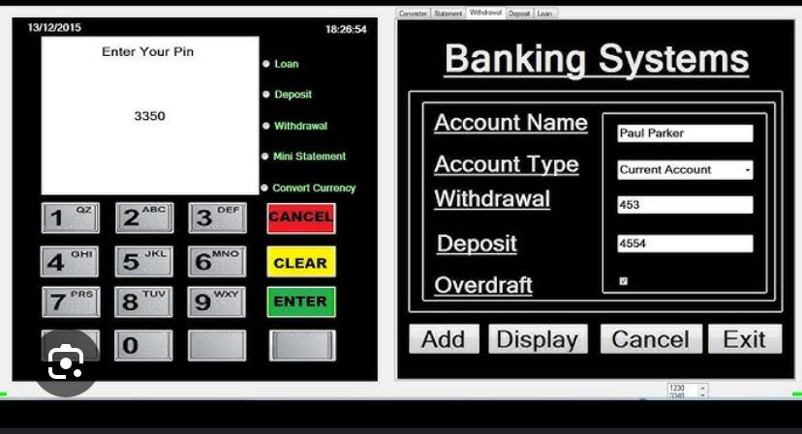
A BANKING APPLICATION TO MANAGE MEMBERS CHECKING AND SAVINGS ACCOUNT

Slide 4
OVERVIEW OF THE APPLICATION AND PURPOSE
The banking application is designed to provide a seamless and efficient way for members to manage their checking and savings accounts. This user-friendly platform offers a range of features that empower users to take control of their finances, ensuring a secure and of features that empower users to take control of their finances, ensuring a secure and convenient banking experience .

Slide 5
KEY OBJECTIVES
*ACCOUNT MANAGEMENT ; Allow users to easily view account balances, transaction histories and transfer funds between accounts.
*BUDGETING TOOLS ; Help users set savings goals and track spending, promoting better financial habits.
*SECURITY ; Implement robust security measures, including multi-factor multi- factor authentication and data encryption to protect users information .

Slide 6
TARGETED AUDIENCE
The application is aimed at individuals seeking to manage their personal finances effectively, whether they are tech-sauvy users or new to digital banking.
*BENEFITS;
Convenience: Access accounts anytime, anywhere through mobile and web platforms.
Real-Time Updates: Receive instant instant notifications for transactions and account changes.
Integration: Connect with external accounts and payments services for a comprehensive banking banking experience .
The aim is to enhance financial management, improve user engagement and foster a sense of control over personal finances .

Slide 7
USER INTERFACE(UI) DESIGN
.KEY COMPONENTS
1.Clean and Intutive Layout
-Priotize simplicity
-Organize information logically
2.Navigation structure
-Implementation of a clear menu with sections
-A prominent search bar was included for quick access to information and transactions
3.Design touch-friendly
-Design touch friendly buttons for easier interaction on mobile screens.
4.Typography
-Use of legible fonts with clear distinctions btw headings and body text for readability.
5.Use Feedback Mechanism
-Provides instant notifications for transactions
-Use of progress indicators during processing to keep users informed

Slide 8
SECURITY FEATURES
*User aunthentication ; Multifactor authentication, Biometric login option
*Data Encryption ; End to end encryption , Secure socket layer(SSL)
*Fraud Detection ; Real-time Monitoring , Transaction Alerts
*User Control ; Account Locking , Recovery Options
*Regular Security Updates ; Frequent Software Updates , Vulnerability Assessments
*Privacy Protection ; Data minimization , User control over data sharing
These features collectively enhance user trust and protect sensitive financial information, ensuring safe banking experience.

Slide 9
INTEGRATION with other SERVICES
* Links to external Accounts
Here, transactions can be imported from other banks.
*Payment Services
Integration with payment platforms ( Paypal , Venmo)

Slide 10
TECHNICAL ARCHITECTURE
*Overview ; Secure and reliable services for customers and bank staff.
*Presentation Layer; Responsive banking app
*Application Layer; Microservices for accounts,transactions and authentication
API gateway and Load balancer for traffic management .
*Data Layer ; Data warehouse for analytics and caching performance.
* Security ; Data Encryption and Authentication
*Infrastructure ; Cloud-based containerization with docker, and CI/CD for deployment
*Compliance ; Adheres to PCI DSS and GDPR with audit logging
* Third-Party Integrations ; Payment gateways
*User Experience ; Easy onboarding , customer support and feedback systems
*Scalability ; Load testing , horizontal scaling and CDN for content delivery

Slide 11
DEVELOPMENT ROADMAP
PHASES OF DEVELOPMENT
*Planning
*Design
*Development
*Testing
*Deployment
*Post-Launch
*Compliance & Security Audits

Slide 12
MARKETING STRATEGY
*Value Proposition ; Referring to to unoque features of the banking app.
*Digital Marketing ; Content marketing and social media campaigns to increase visibility. Engagement with potentail users through targeted ads on platforms like google/facebook
*Partnership ; Collaboration with fintech companies and local businesses for cross promotions
*Referral Programs ; Incentivize existing users to refer new customers through rewards
*Customer Education ; Availability of resources to educate users on app features and financial literary
*Feedbacl Loop ; Actively gather user feedback to improve the app and enhance customer satisfaction
*Promotions ; Offer limited-time promotions to attract new users
Thereby effectively reaching and engaging potential customers while building long-term relationships .

Slide 13
CONCLUSION
In conclusion, the banking app represents a significant advancement in providing secure, convenient, and user-friendly financial services. By leveraging modern technologies and adhering to regulatory standards, the app meets the diverse needs of users while ensuring data security and compliance. The structured development approach ensures a reliable and efficient application, while the targeted marketing strategy aims to attract and retain customers. With features designed to enhance user experience, such as intuitive navigation and robust customer support, the app is positioned to become a trusted solution in the competitive banking landscape.
As we move forward, continuous improvement based on user feedback and industry trends will be key to maintaining relevance and delivering exceptional value to our customers.

Slide 14
QUESTIONS & ANSWERS
Any questions?
And we are open to feedback and ideas

